Slide 1

Analyzing Conagra's Sales Data: Insights for Future Business Decisions
A MACHINE LEARNING APPROACH

Slide 2
CONTENTS
Introduction
Market Research and Statistics
Key Questions
Competitors
Demographic
Regression
Time Series Forecasting
Product Attributes
Actionable Insights
Summary

Slide 3
MARKET RESEARCH AND STATS
The table spreads market in the US was valued at $1.1 billion in 2020, and it is projected to grow at a CAGR of 3.5% from 2021 to 2028. Conagra has a market share of around 22%.
Consumer preferences: According to a Mintel survey, 54% of US consumers prefer margarine and spreads that are made from natural ingredients, while 37% prefer low-fat products.
Competitive landscape: Other major players in the table spreads market include Unilever, Kerry Group, and Land O'Lakes.
Pricing strategy: Conagra has adopted a competitive pricing strategy in the table spreads market to remain competitive and gain market share.

Slide 4
KEY QUESTIONS
How do our loyalty and sales compare to our competitors in the table spreads category?
Who is our target audience based on region, gender, income, marital status, etc. and how can we tailor our marketing efforts to maximize sales?
What is our sales forecast for the table spreads category and how can we improve it?
What is the impact of merchandising on our table spreads sales?
What is the impact of product features on our table spread sales?
How do cooking spray, cooking oils, and table spreads interact with each other in terms of sales?

Slide 5
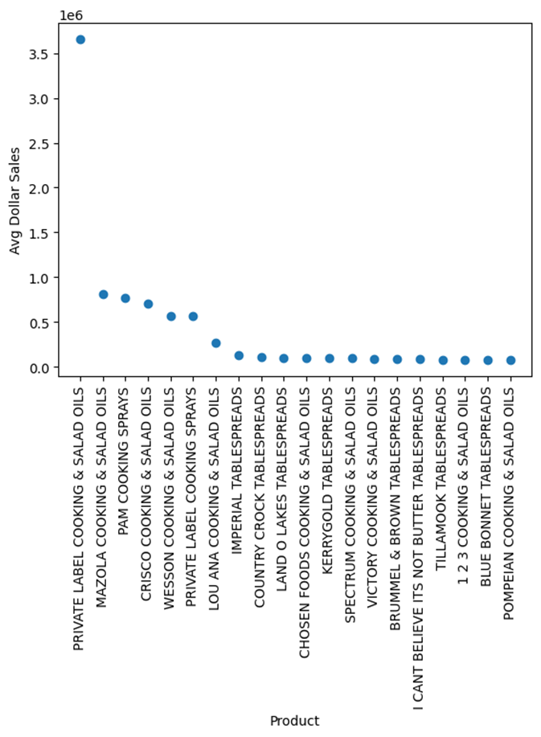
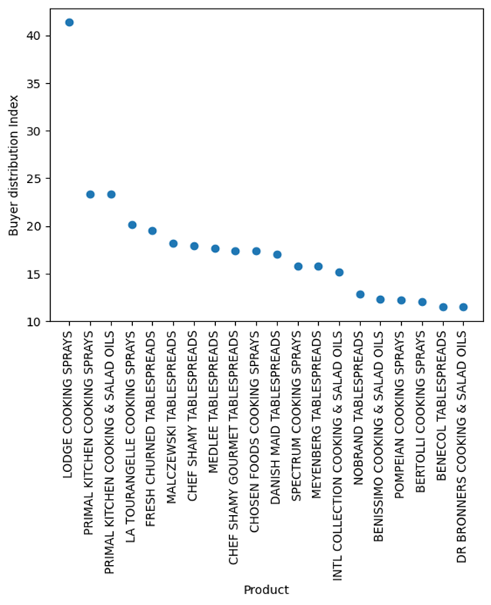
COMPETITORS
SALES BASED COMPETITORS
LOYALTY BASED COMPETITORS
Brands like Lodge, Primal, and La Tourangelle have established a loyal customer base with high conversion rates.
Brands like Private Label, Mazola, PAM, and Crisco have high Sales.
Competitor analysis can help identify gaps in the market, potential threats, and opportunities for growth, and provide insights into customer behavior, industry trends, and best practices in the market.

Slide 6
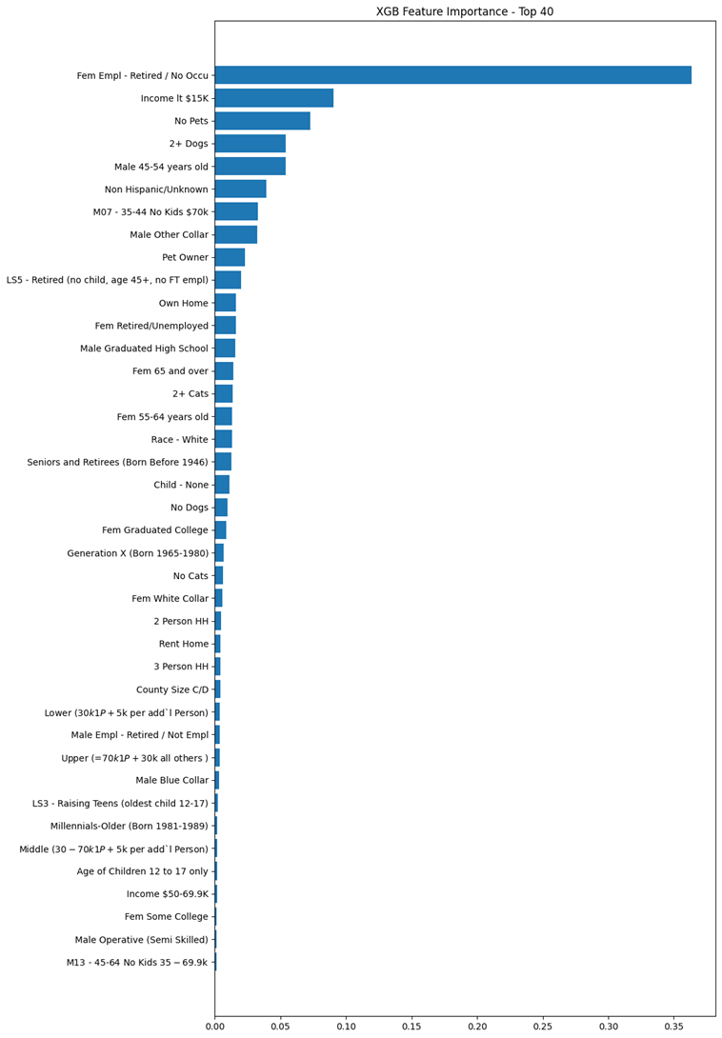
DEMOGRAPHIC
Employed XGBoost based feature selection method for analyzing demographic data
The largest user group/ buyers for table ads and its substitution categories like cooking sprays and cooking oils are the middle-class females who are either housewives or retired.

Slide 7
REGRESSION
Sales forecasting can use both regression analysis and time series analysis techniques, depending on the nature of the sales data and business needs.
Combining these techniques can result in a more accurate and comprehensive sales forecast by analyzing the relationship between sales and various factors and identifying patterns and trends in historical sales data.

Slide 8
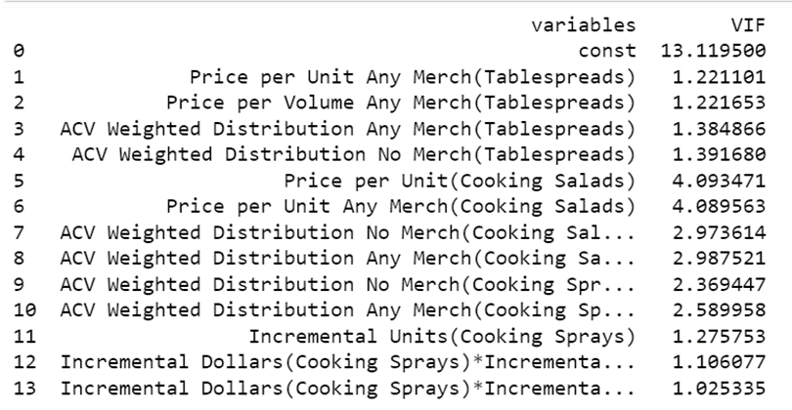
REGRESSION
The given sales data has high multicollinearity
We first created a linear regression model and calculated the VIF for each variable.
We then set a threshold for high VIF and identify the variables that have a VIF above that threshold.
If the VIF value for a variable is greater than 5 or 10, it indicates that there is a high degree of multicollinearity

Slide 9
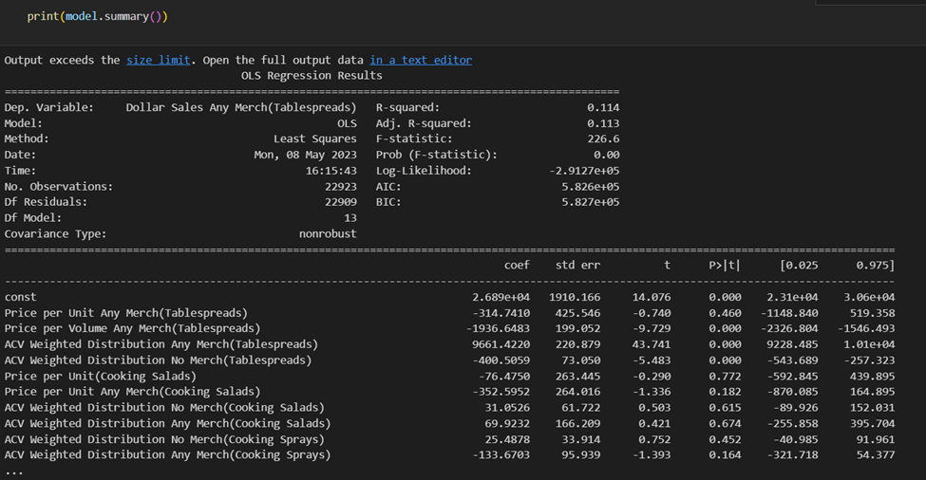
REGRESSION
The coefficients for Price per Unit Any Merch (Table spreads) and Price per Unit (Cooking Salads) are negative, indicating that an increase in these variables leads to a decrease in the dollar sales of table spreads.
the ACV Weighted Distribution Any Merch (Table spreads) and ACV Weighted Distribution No Merch (Table spreads) variables have a positive and negative coefficient, respectively, indicating that increasing the distribution of table spreads in stores with merchandising leads to higher dollar sales.
However, low R-square and presence of multicollinearity makes Regression unsuitable for Sales data forecasting but useful for understanding the relationship between the variables.
This is where time series comes into place.

Slide 10
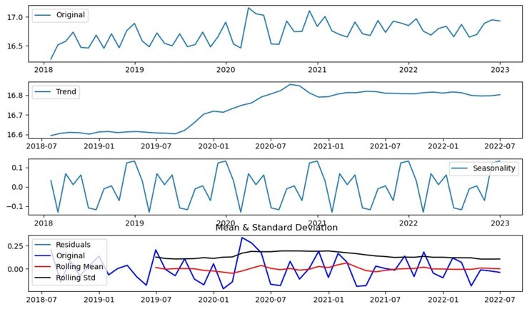
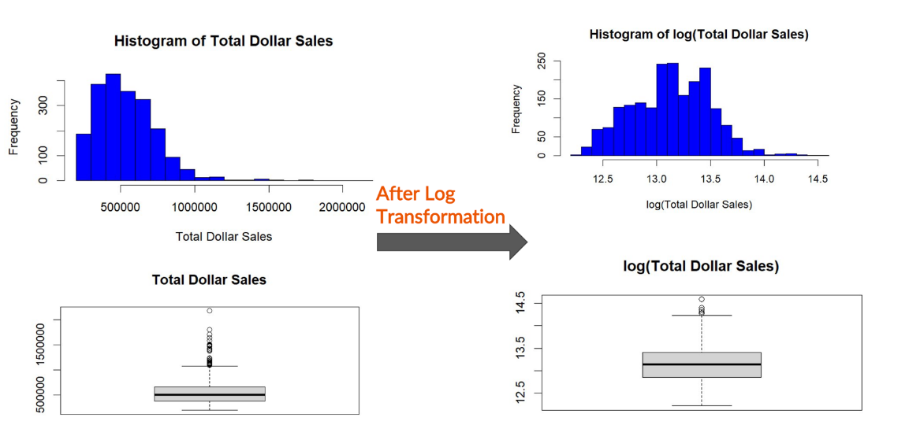
TIME-SERIES FORECASTING
As we see the Table Spread Data on the Dollar Sales is Right Skewed, Having More outliers as shown in the box plot above. To make the data normal, we applied a natural log to the data to make the data normal. With this data we can eliminate the bias and omit necessary outliers which pull the regression line.
From the above graphs we can see the original data, Seasonality, Trend along with Rolling Mean and Std wr.t data.

Slide 11
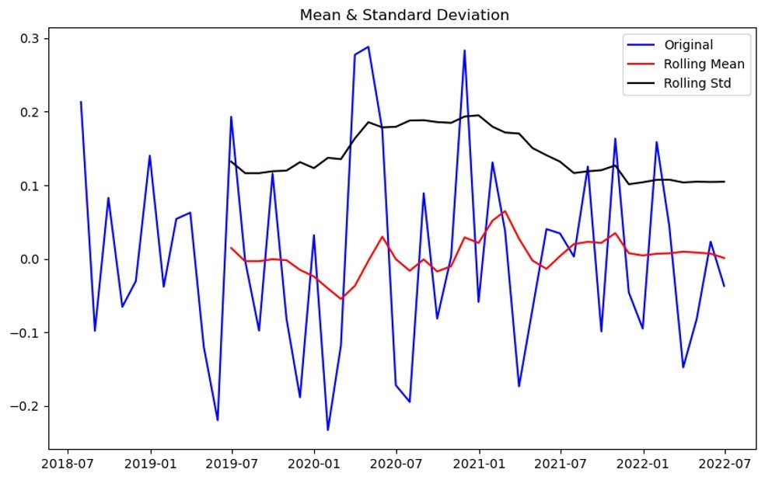
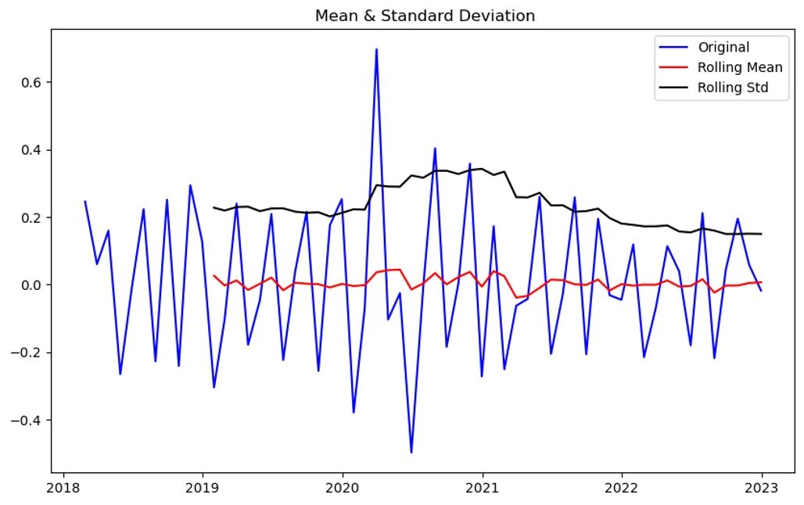
TIME-SERIES FORECASTING
As per the moving average concept, We take the average of the first four months and then so on till the end, then take the average of that differentiated mean provides us with following figure
Here, we can see that the mean and standard deviation of the data is almost in a straight line (conditions for Data to be stationary). This is how you make the data Stationary.

Slide 12
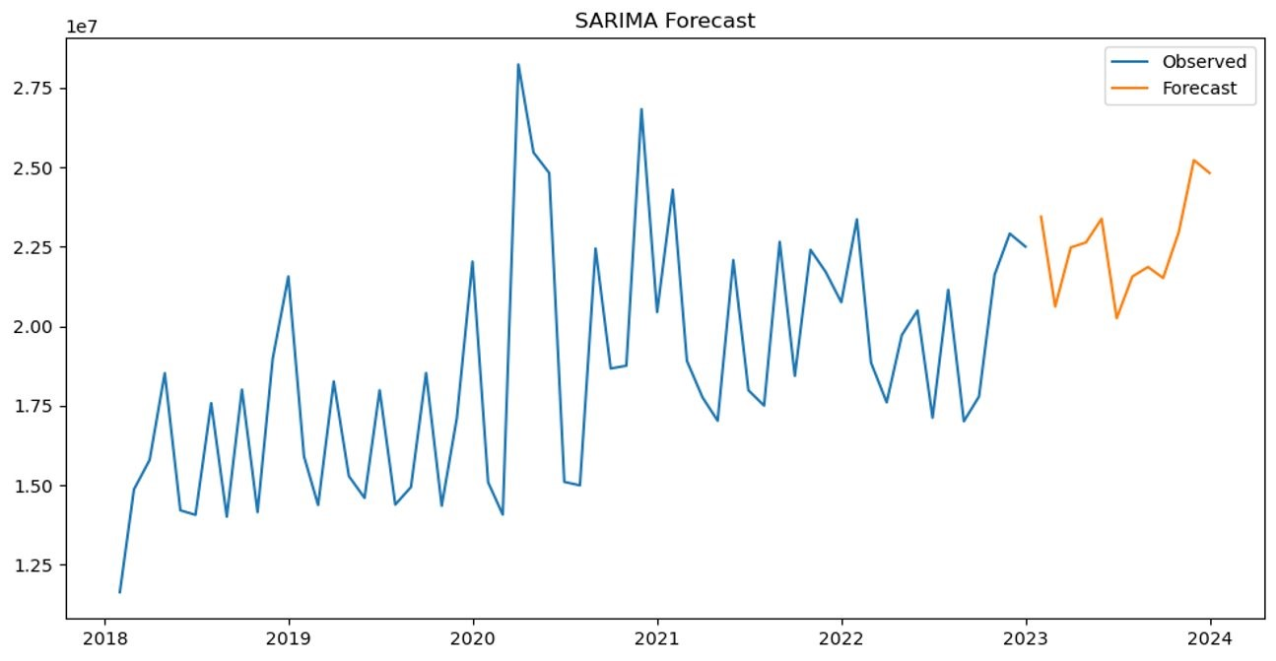
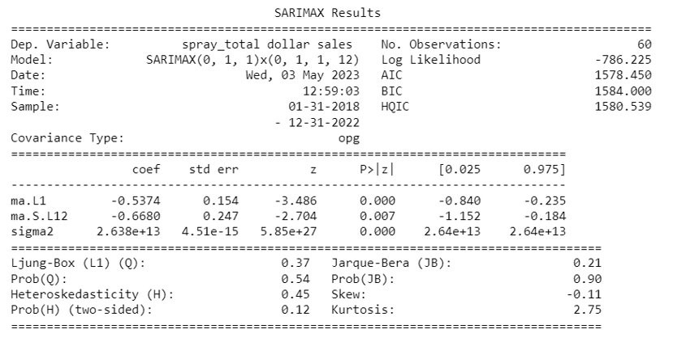
TIME-SERIES FORECASTING
By using the SARIMAX code, we predicted the Values of sales for 2023 and 2024.
In This SARIMA process, We Find the Moving Average of the Data, then find the Seasonality component, Find the Trend component, Then Average Both Seasonality and Trend components for respective Month Variable, with this ST, we remove seasonality of the data which then use to predict the future values

Slide 13
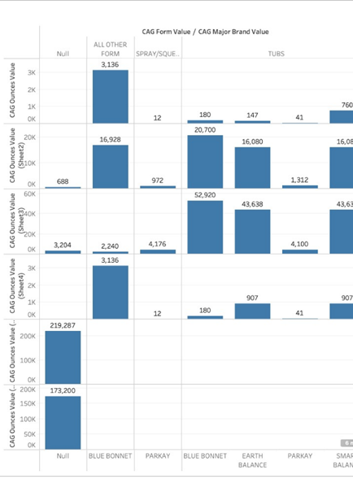
PRODUCT ATTRIBUTES
We performed k-means clustering on the table spreads data. From the 6 clusters we chose the cluster that had the highest average sales

Slide 14
KEY FINDINGS
Competitor analysis shows that certain brands have established a loyal customer base with high conversion rates and others have high sales.
Middle-class females who are housewives or retired make up the largest buyer group for table spreads and its substitution categories like cooking sprays and cooking oils.
The regression analysis shows that distribution in stores with merchandising leads to higher dollar sales, while price per unit has a negative relationship with sales.
Products in Stick form, 16 ounces have the highest sales in the cluster and contribute positively to sales.

Slide 15
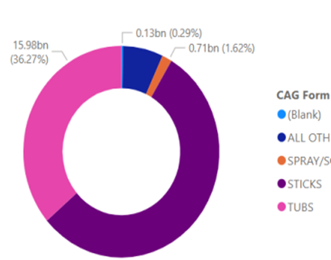
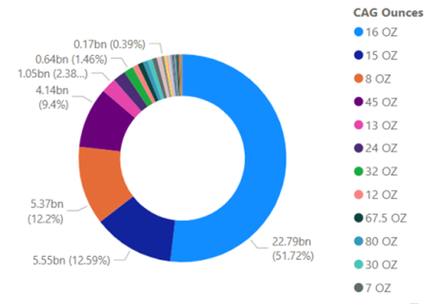
PRODUCT ATTRIBUTES
Products in Stick form, 16 ounces have the highest sales in the cluster and contribute positively to sales.

Slide 16
RECOMMENDATIONS
Conagra should analyze the marketing strategies, product features, and pricing strategies of successful competitor brands like Private Label, Mazola, PAM, and Crisco to understand what they are doing better to maintain brand loyalty.
Conagra should tailor their marketing and advertising strategies to target the largest buyer group for table spreads effectively i.e., Retired Middle Class Married Females
Conagra should focus on improving the distribution of table spreads in stores with merchandising to drive higher sales and increase promotional activity.
Conagra should produce and promote products in Stick form, 16 ounces, and explore the factors that make these products successful.

